Slide 1
Fighting Fake News & Alternative Facts
Evaluating Information Literacy
McGeorge Education Services (MES), Fall 2020

Slide 2
Why does it matter?
CRA(A)P SIFT
Three Scenarios
Warner, J. (2019, August 14). Getting beyond the CRAAP test: A conversation with Mike Caulfield. Inside Higher Ed. https://www.insidehighered.com/blogs/just-visiting/getting-beyond-craap-test-conversation-mike-caulfield
Notes:
The CRAAP test is an older school approach to evaluating print resources (like a book or journal) to purchase as part of a library collection. The acronym stands for currency (timeliness), relevance, authority, accuracy, and purpose.
It’s important to move past CRAAP into a different evaluation path because copying and pasting an evaluative approach from one mode to another does not work or cannot account for any of the pervasive issues observed these days with fake news misinformation, and disinformation. Also, a lot of SIFT moves subsume the ideas conveyed in the CRAAP acronym.
The three scenarios look at some of the ways information can be presented in misleading and dangerous ways, highlighting the importance of

Slide 3
Stop Investigate the source Find trusted coverage Trace claims, quotes, and media
SIFT
Caulfield, M. (2019, June 19). SIFT (The four moves). Hapgood. https://hapgood.us/2019/06/19/sift-the-four-moves/
Notes:
Stop refers to both surface-level and deep-dive reminders. First, ask if you know the site or source, along with their reputation. If, once you start interacting with a material, you start to feel overwhelmed, stop and remember your purpose.
Have an idea of what you are reading before you start reading it. If you don’t realize until after you’ve read or looked at a piece where it came from or who sponsored it, it can be hard to shake the information and be objective in hindsight.
Look beyond the source you landed upon, and instead, consider investigating the claim that it makes in more depth with other, more reliable or trustworthy sources. This interplays well with the last move.
Trace resources or content back to its original source or context, if possible. This is especially true with social media, which is designed to spread information quickly; forums like Twitter or Instagram that make bold or provocative statements should not be taken at face value and at the very least should encourage you to probe more deeply, hopefully by providing reliable links back to more detailed information or the source of the information.

Slide 4
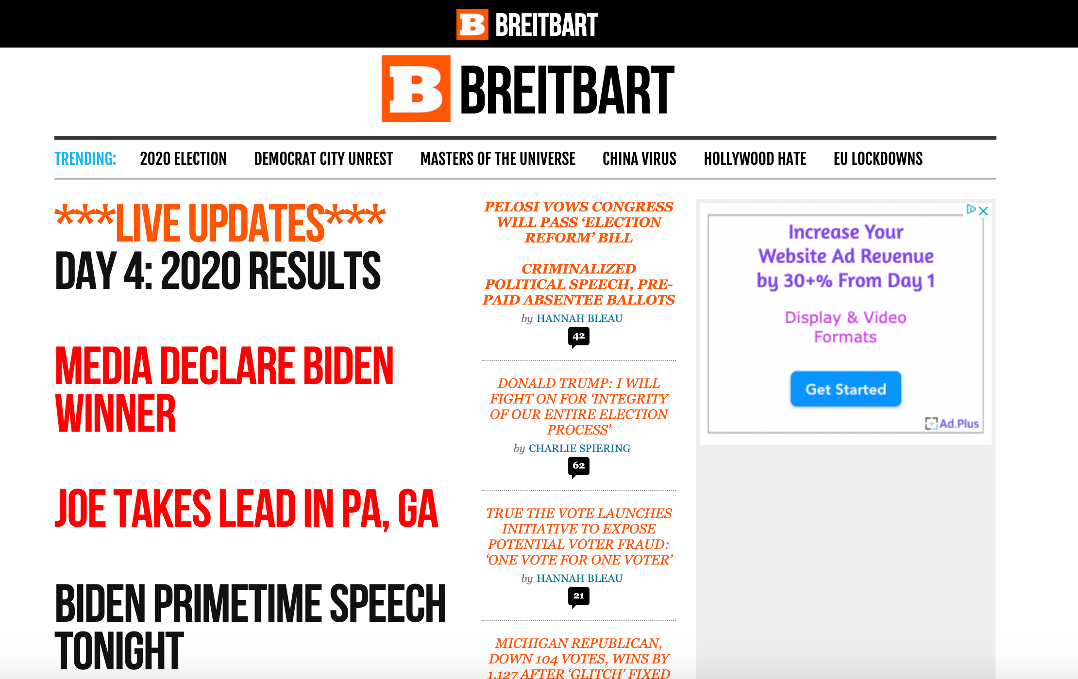
SIFT
1
Scenario
What’s the source?
Why are you investigating this source or information in the first place?
What is the claim, and where can you find more trusted information about it?
How can you trace the claim back to another source?
Notes:
1

Slide 5
SIFT
1
Scenario
The source is Breitbart news. Their “about us” includes a word cloud of famous right-wing “influencers” who have appeared on their platform.
You might be looking at this site for election coverage.
One claim is “Media Declare Biden Winner.”
You can look at multiple media outlets, all covering the election results.
Initial reactions?
Breitbart. (2020, November 6). https://www.breitbart.com/

Slide 6
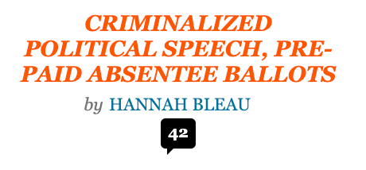
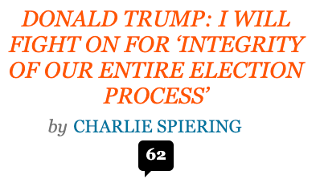
SIFT
1
Scenario
If the source alienates entire demographics, red flag!
If “Media” suggest Biden is the winner, how is Breitbart different?
What does this home page actually tell you about the election?
What does this home page tell you about Breitbart values?
Breitbart. (2020, November 6). Who Brieitbart is…really. https://media.breitbart.com/media/2019/11/about-breitbart-news.pdf/
Notes:
For the uninitiated, you probably don’t need to travel further than the home page to determine that this “news” site is biased. Headings like the vague “Masters of the Universe” and the less vague “China Virus” and “Hollywood Hate” paint a picture of the kind of content featured on the stie. This might seem like an obviously biased publication, yet there are still plenty of people who use it to bolster arguments and dump memes.
If you intentionally visit this site for election coverage, it is likely because you sought out Breitbart (perhaps someone you know referenced it or provided it as a source) or because you were intentionally trying to see the coverage.
According to Breitbart’s “About us” section, they are a news organization, which suggests that they don’t see themselves as part of the same “Media” they outline on the home page. Further digging into their “about me” section shows a list of accolades and accomplishments, which all have to do with interaction and engagement, not necessarily with content or awards given for hard-hitting journalism. This is further reflected on their home page with a focus on how many comments they can generate, indicating traffic to their site, which they have already acknowledged as one of the most important facts about their news organization.

Slide 7
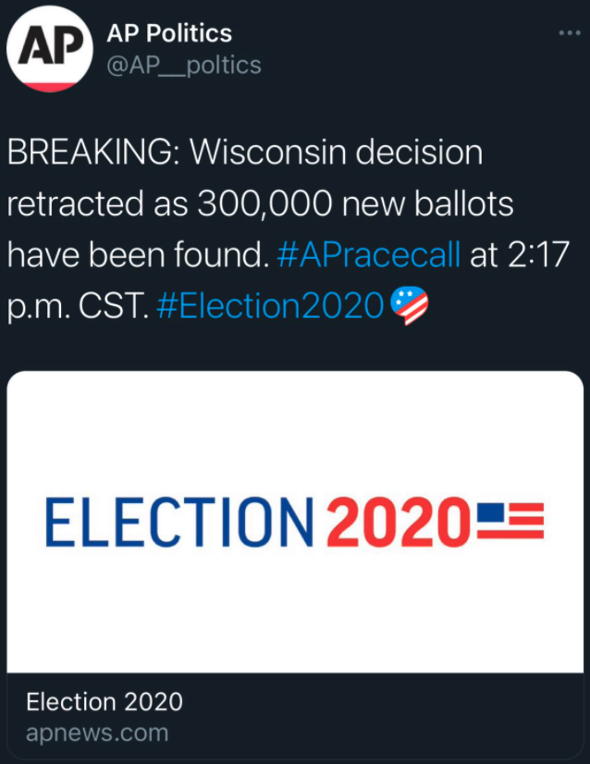
SIFT
2
Scenario
What’s the source?
Why are you investigating this source or information in the first place?
What is the claim, and where can you find more trusted information about it?
How can you trace the claim this tweet makes back to another source?

Slide 8
SIFT
2
Scenario
The Associated Press (AP) logo is familiar and trustworthy.
You’re seeing this source because of contentious election results (it plays to emotions).
A decision in a presidential election has been “retracted” and ballots have been “found.”
Look for more links, and if not, google.
Initial reactions?
Twitter.com (2020, November 4). Fake election post. Post since deleted. Screenshot by author.

Slide 9
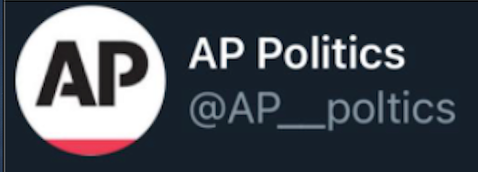
SIFT
2
Scenario
The Associated Press (AP) logo is familiar and trustworthy.
The Twitter handle is misspelled! Red flag!
A quick google search and the real AP site explain a misinformation campaign to cast election doubts.
Seitz, A., Klepper, D., & Swenson, A. (2020, November 5). Trump and allies spread falsehoods to cast doubt on election. Associated Press. https://apnews.com/article/election-2020-joe-biden-donald-trump-wisconsin-misinformation-013e89a828a01668ba3da6a2f6f91ca9

Slide 10
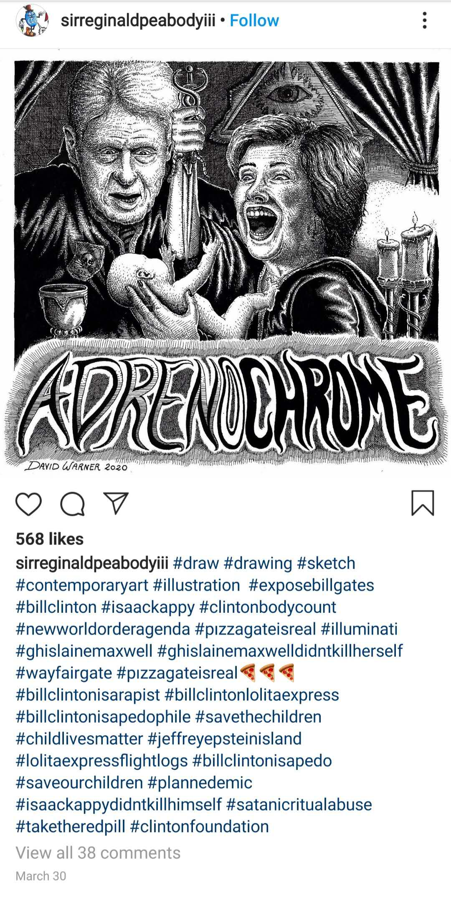
SIFT
3
Scenario
What’s the source?
Why are you investigating this source or information in the first place?
What is the claim, and where can you find more trusted information about it?
How can you trace the claim this tweet makes back to another source?

Slide 11
SIFT
3
Scenario
The source is Instagram, so it is likely created by average people to be shared (i.e., not a news outlet).
You searched for a hashtag, someone shared the image, or it popped up in your IG feed.
The “claim” this image makes is based on a debunked conspiracy theory.
Look for more links, and if not, google.
Initial reactions?
Peabody, S.R. [@sirreginaldpeabodyiii] (2020, March 30). #pizzagateisreal https://www.instagram.com/p/B-W9pkclopN/?igshid=10wjigcefdrk6

Slide 12
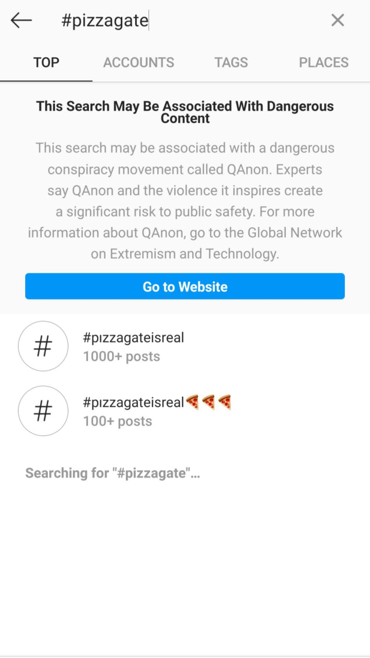
SIFT
3
Scenario
When searching for #pizzagate or #pizzagateisreal, a warning pops up.
This singular conspiracy theory is part of a larger, more dangerous network of conspiracy theories.
The “claim” this image makes is based on a debunked conspiracy theory.
Look for more links, and if not, google.
Kang, C. (2016, November 21). Fake news onslaught targets pizzeria as nest of child-trafficking. The New York Times. https://www.nytimes.com/2016/11/21/technology/fact-check-this-pizzeria-is-not-a-child-trafficking-site.html

Slide 13
Conclusions
Biased information or “fake news” can seem obvious, but people still believe it.
Disinformation may be intentionally designed to be deceptive.
Disinformation and conspiracy theories can persist and become larger, more dangerous movements.

